Slide 1
Targeted Synthetic BLE Packet Data Generation Approach
17.03.2025
Keisuke Yokota

Slide 2
Executive Summary
Recap of Previous Presentation
Index
Results
Discussion
Final Considerations

Slide 3
Executive Summary
Recap of Previous Presentation
Index
Results
Discussion
Final Considerations

Slide 4



Executive Summary
The Goal
Investigate the usefulness of the Markov model in synthesizing data in BLE packets
Clarify that a Markov model is appropriate for creating BLE data
Create a synthesis data of BLE using a Markov model
Evaluate the synthetic data
The Method
Generated synthetic data with the Markov model
Investigated the characteristics of each method and the features of BLE packet data
Implemented the Markov model
The Results
Confirmed that synthetic data produced by the Markov model improved the ML model
Compared the structure of data with synthetic data and the original data
Compared the confidence levels between models with and without synthetic data

Slide 5
Executive Summary
Recap of Previous Presentation
Index
Results
Discussion
Final Considerations

Slide 6



The current state of BLE
BLE is Abused
The Need for Synthetic Data
Importance of large dataset
Large dataset
Diverse dataset
Examples of BLE Abuse
AirTag is slipped into a car to obtain location data illegally (Bern, 2022)
A woman used an AirTag to track her boyfriend and later killed him (US, 2022)
A woman was stalked by her ex-boyfriend using an AirTag, and she was ultimately shot with a gun. (US 2022)
Cost and Risk
Time and monetary cost
Privacy issues
It is important to develop a model
to detect and classify BLE devices
Synthetic data resolves these problems
https://www.statista.com/statistics/750569/worldwide-bluetooth-low-energy-device-market-volume/, https://www.20min.ch/story/ich-hatte-panik-bernerin-19-findet-fremden-airtag-unter-ihrem-beifahrersitz-460234987350, https://www.nzz.ch/panorama/airtag-stalking-hat-apple-die-gefahr-unterschaetzt-ld.1688765?reduced=true
BLE is abused.
Notes:
↓AirTagを使用した事件
https://ascii.jp/elem/000/004/219/4219026/

Slide 7





Research Questions
Clarify the appropriateness of the Markov model for creating BLE data.
Goals
Create synthetic data of BLE using a Markov model
Evaluate the synthetic data
Notes:
The objective of this research is to generate high-quality synthetic data of BLE packets using the Markov model.

Slide 8
Method Selection
Markov Model
Hidden Markov Model
GAN
Suitable for time-series data
Suitable for structured data
Suitable for complex structured data
Suitable when interested in the underlying states of the data
Ensuring data diversity
Not suitable for structured data
BLE packet data is time-series and structured data.
The main goal is to generate synthetic data, not investigate hidden states.
BLE is structured data.
Notes:
Given that BLE packet data has a defined structure and is time-series in nature, the Markov Model is chosen.
BLEパケットデータは構造が決まっていることと、時系列データであることからマルコフモデルを選択する。

Slide 9



Data Selection
Preprocessed SmartTag (nearby)
SmartTag (nearby)
Preprocessed
Small data volume
Can be compared with Stefan's results
Low accuracy
The existing model
can be used

Slide 10
Synthetic Data Generation Pipeline

Slide 11


Example of the State Transition
State Transition Model
State Transition Matrix
Next State
CH 39
CH 38
CH 37
CH 39
0.000000
0.000419
0.999581
Current State
CH 38
0.333054
0.001398
0.665549
CH 37
0.000069
0.492758
0.507173

Slide 12
Executive Summary
Recap of Previous Presentation
Index
Results
Discussion
Final Considerations

Slide 13

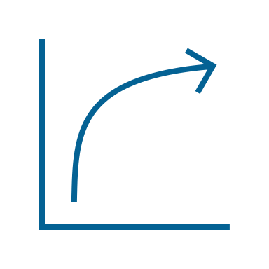
Evaluation Perspectives
Data Structure
Confidence Lebel
Compare the structure of data with synthetic data and original data.
Compare confidence levels between models with and without synthetic data.
Notes:
The next task is to evaluate the synthetic data. The evaluation will be conducted from two perspectives.

Slide 14
Comparison of Data Structures
Diagram
Matrix
CH 37
CH 38
CH 39
Original
60.316998
29.765371
9.917630
Synthetic
60.334167
29.711667
9.954167
No significant structural difference between original and synthetic datasets

Slide 15
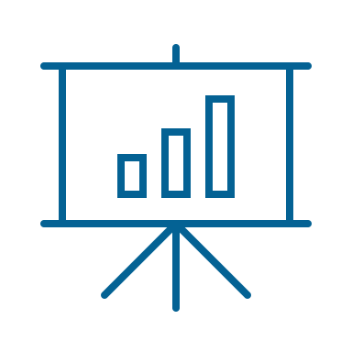
Comparison of Data Structures
Length
Advertising Data type

Slide 16
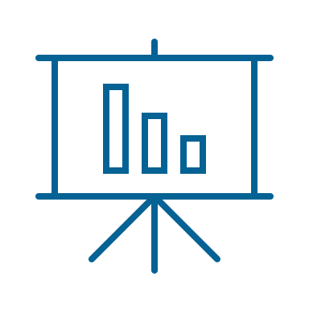
Comparison of Data Structures
PDU
UUID
SmartTag type

Slide 17

Comparison of the Models with and without Synthetic Data
Model - o
Model - S
Model - M
Model Type
Neural Network
Neural Network
Neural Network
Data
Original dataset
Original dataset
+ Synthetic dataset
Original dataset
+ Synthetic dataset
Method
-
Duplicating
The Markov model
Details
-
Duplicated misclassified SmartTag (nearby) data from real data and labeled it as 'Other'.
Applied the Markov model to SmartTag (nearby) data obtained inside a Faraday cage.

Slide 18

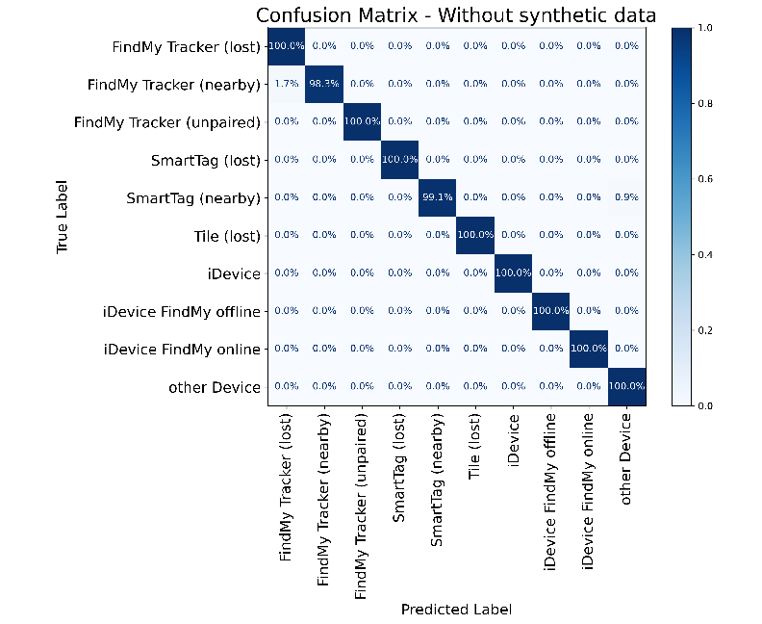
Comparison of Results on Test Data
Confusion Matrix and Results for SmatTag (nearby)
Insights from Test Data
Results for SmatTag (nearby)
Model
Probability
The test data achieve sufficient accuracy even without synthetic data.
The classification accuracy for SmartTag (nearby) in the test data improved further with synthetic data generated by the Markov model.
Model - o
99.1%
Model - s
99.0%
Model - m
99.9%

Slide 19
Comparison of Results with Real Data – SmartTag (nearby)
The synthetic data improves the accuracy for SmartTag (nearby) compared to real data.
Without (Model – o)
Duplicating (Model – s)
Markov model (Model – m)

Slide 20
Comparison of Results with Real Data – Tile (lost)
Devices that originally had high accuracy maintained their performance.
Without (Model – o)
Duplicating (Model – s)
Markov model (Model – m)

Slide 21
Comparison of Results with Real Data – FindMy Tracker (unpaired)
However, for a small subset of devices, accuracy decreased.
Without (Model – o)
Duplicating (Model – s)
Markov model (Model – m)

Slide 22
Results with Varying Synthetic Data Ratio in Training SmartTag (nearby)
0 %
10 %
30 %
50 %
75 %
100 %

Slide 23
Executive Summary
Recap of Previous Presentation
Index
Results
Discussion
Final Considerations

Slide 24


Discussion - Why Synthetic Data Enhanced the Model
The classification accuracy
improved with synthetic data
The proportions of each value
are almost equal
Accuracy improved with synthetic data due to enhanced diversity, not increased volume.
The increase in data diversity was not due to individual column variations but to the expansion of column value combinations.

Slide 25
Discussions - Synthetic Data is Not a Perfect Solution
Even with synthetic data, the confidence
level for about 15% of the data remains low
Using synthetic data lowered
the confidence level for some devices
The diversity provided
by the Markov model is limited.
The synthetic data may have closely resembled existing data, potentially reducing accuracy.

Slide 26




Discussion - Advantages of the Markov Model
Generating synthetic data with the Markov model reduces three types of costs.
Time cost
Computational cost
Monetary cost

Slide 27
Executive Summary
Recap of Previous Presentation
Index
Results
Discussion
Final Considerations

Slide 28
Answers to Research Questions
Research Questions
Answers
Clarify the appropriateness of the Markov model for creating BLE data
The Markov model is suitable for synthesizing BLE packet data
The Markov model is well-suited for structured and time-series data. BLE packet data is both structured and time-series data.
Create synthetic data of BLE using a Markov model
Preprocessed SmartTag (nearby) was synthesized by the Markov model
SmartTag (nearby) data is relatively scarce and has lower classification accuracy. Handling preprocessed data allows for immediate use in training.
Evaluate the synthetic data
Synthetic data improved the model's accuracy
The accuracy increased due to enhanced diversity, not just a larger data volume. The number of unique combinations of column values increased.

Slide 29



Limitations
Limited Generalizability
Dependence on Markov Assumption
Synthetic Data Realism
The results obtained in this study may not necessarily apply to devices other than SmartTag (nearby).
The method is ineffective if BLE packet data exhibits non-Markovian behavior. For example, it is unsuitable when packet loss occurs due to noise or signal interference.
Synthetic data does not always represent real-world data. Some generated data may contain unrealistic value combinations.

Slide 30



Future work
Different Devices
SmartTag (lost)
FindMy Tracker (unpaired)
Alternative Methods
GAN
VAE
Other Data Sources
Real Data
Kaggle

Slide 31
Questions?

